Slide 1
Introduction
Lecturer: BuiHa Duc, PhD
Department of Mechatronics

Slide 2
Course Objectives
This course is designed to provide student with:
Fundamental principles, design considerations,of Real-time system
Ability to implement a real-time system
Hands-on experience through programming assignments and projects using an RTOS

Slide 3
Course outline
Introduction to Real-time system
  Process
  Process block control
  Real-time operating system
Real-time system model:
  Task scheduling
  Hard and soft real-time systems
  Periodic task model, aperiodic task, sporadic task
Clock-driven scheduling

Slide 4
Course outline
Priority-driven scheduling
Dynamic/Static systems
Rate-monotonic scheduling
Validating timing scheduling
Synchronization:
  critical-section
  Semaphores
  Monitors

Slide 5
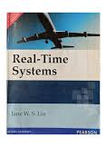
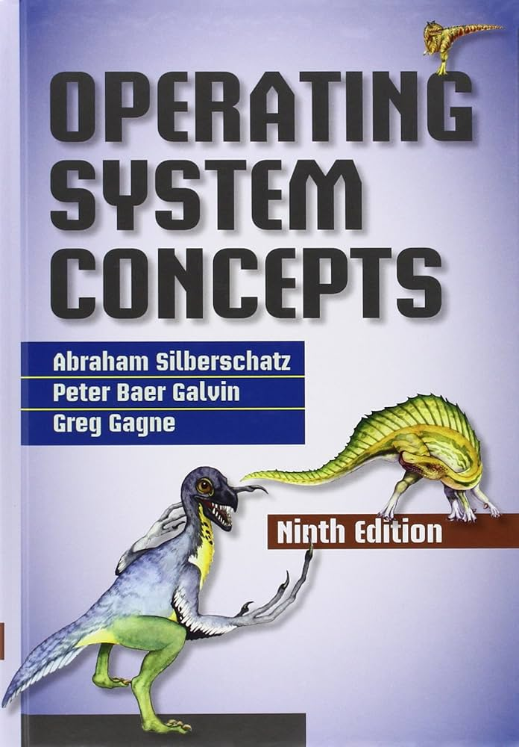
References
Real-time Systems
Jane W. S. Liu , Prentice-Hall , 2000
Operating System Concepts
Sliberschatz, Galvin and Gagne , John Wiley & Sons Inc. , 2018

Slide 6
Online Materials
STM: FreeRTOS on STM32
  Links: https://www.youtube.com/playlist?list=PLnMKNibPkDnExrAsDpjjF1PsvtoAIBquX
Digikey: Introduction to RTOS
  Link: https://www.youtube.com/watch?v=F321087yYy4&list=PLEBQazB0HUyQ4hAPU1cJED6t3DU0h34bz

Slide 7

Assessments
Quizzes and Project – 50%
  1 in-class Quiz
  1 Project
Final Examination – 50%

Slide 8
Review of Microcontroller
What is a Microcontroller?
How does Microcontroller work?
Components of a Microcontroller?
What is a Microcontroller program?

Slide 9
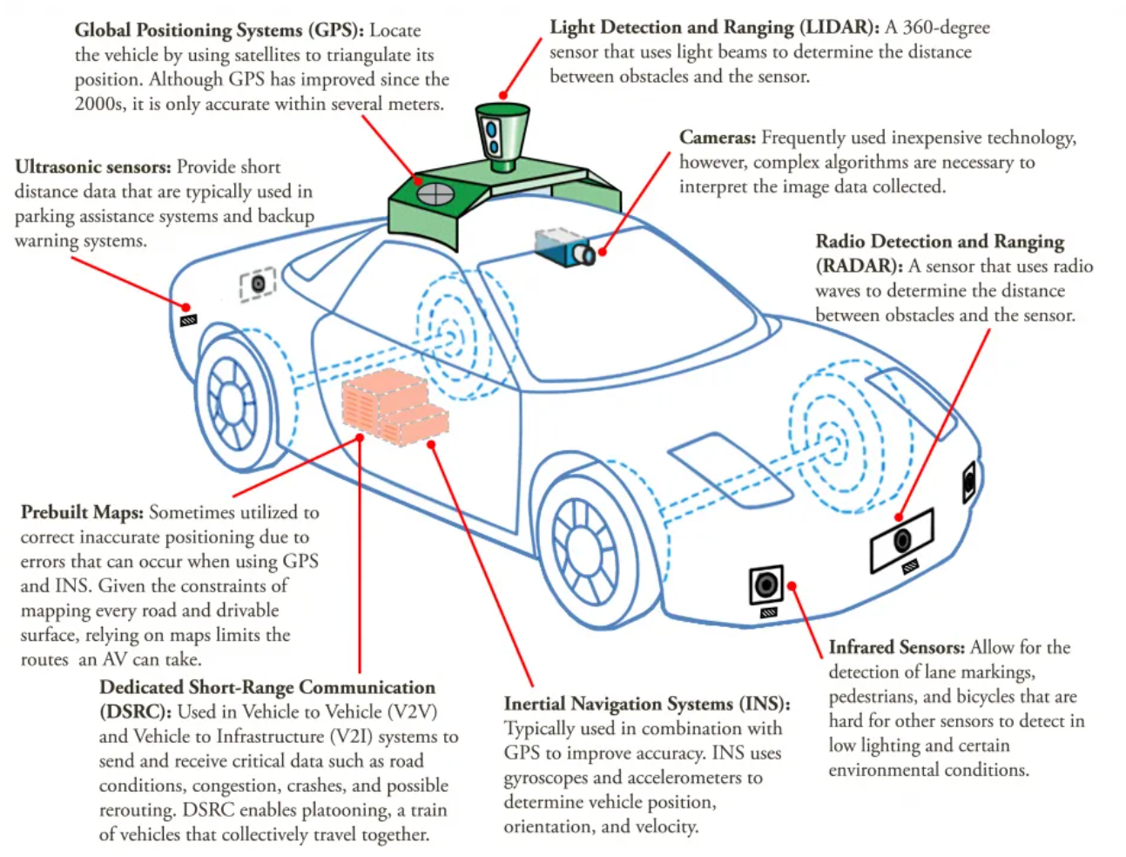
Robot’s Control architecture

Slide 10
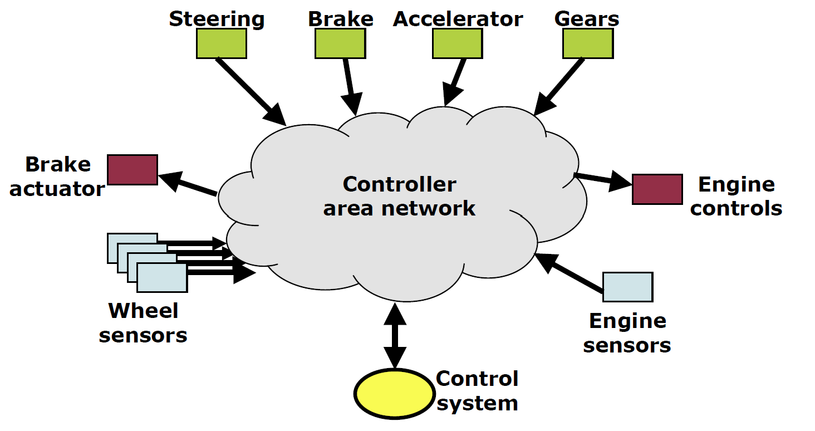
Robot’s Control architecture

Slide 11
Robot’s Control architecture
Low-level
(real-time)
Purpose:
- Directly controls actuators, motors, and sensors
- Must respond in few milliseconds
Hardware:
- Microcontroller, Real-time Processor
- FPGA
- Free RTOS, Zephyr
Intermediate-level
(soft real-time or near real-time)
Purpose:
- Navigating, digital signal processing
- Time scale of ms to seconds
Hardware:
- Single-board computer (raspberry pi, orange pi…)
- Linux OS, ROS
High-level
(non real-time)
Purpose:
- cognitive and computationally heavy tasks
- Time scale of a few seconds
Hardware:
- miniPC, SBC with GPU (nvidia jetson)
- Cloud server

Slide 12
Real-time system
Myth | Truth
The Real-Time Computing is equivalent to fast computing? | The Real-Time Computing is equivalent to Predictable computing
The Real-Time Computing means higher performance | In Real-Time Computing timeliness is more important than performance.
Real-time deals with guarantees, not with raw speed

Slide 13
Real-time system
“A Real time system is one in which the correctness of the computations not only depends upon the logical correctness of the computation, but also upon the time at which the result is produced . If the timing constraints are not met, system failure is said to have occurred”

Slide 14
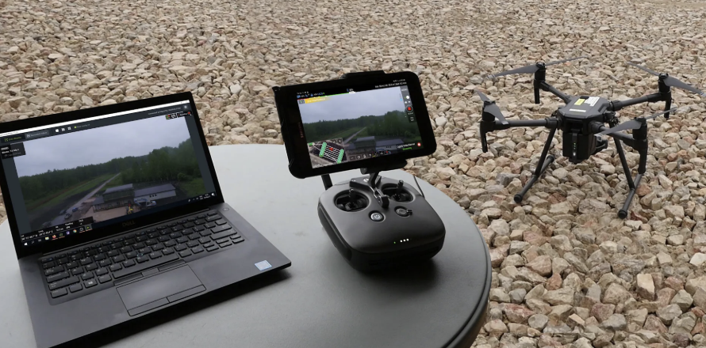
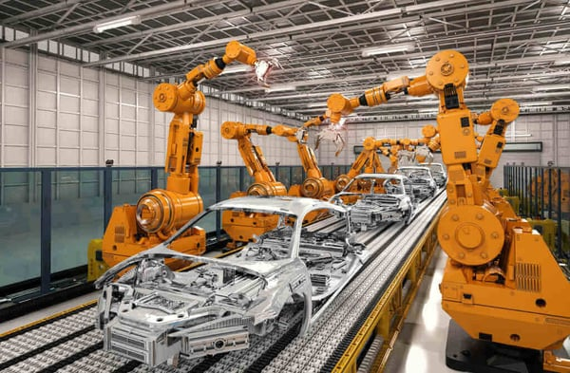

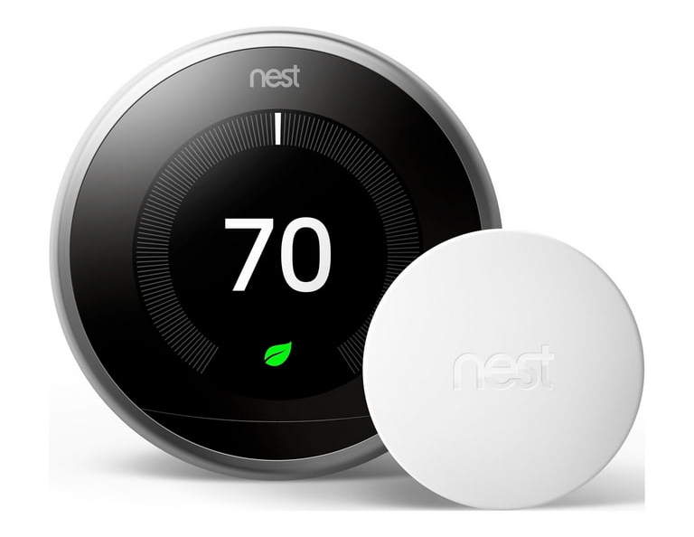
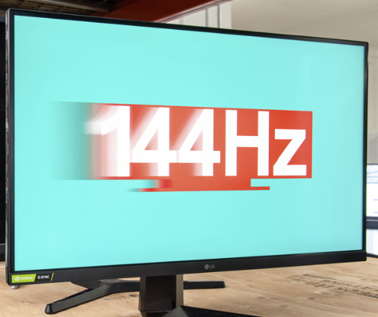
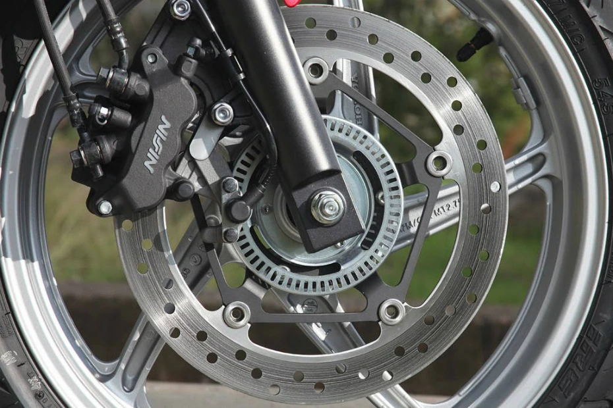
Real-time system
Hard real-time
Actions must complete within a given time limit.
Soft real-time
Small deviation in response time is tolerable

Slide 15
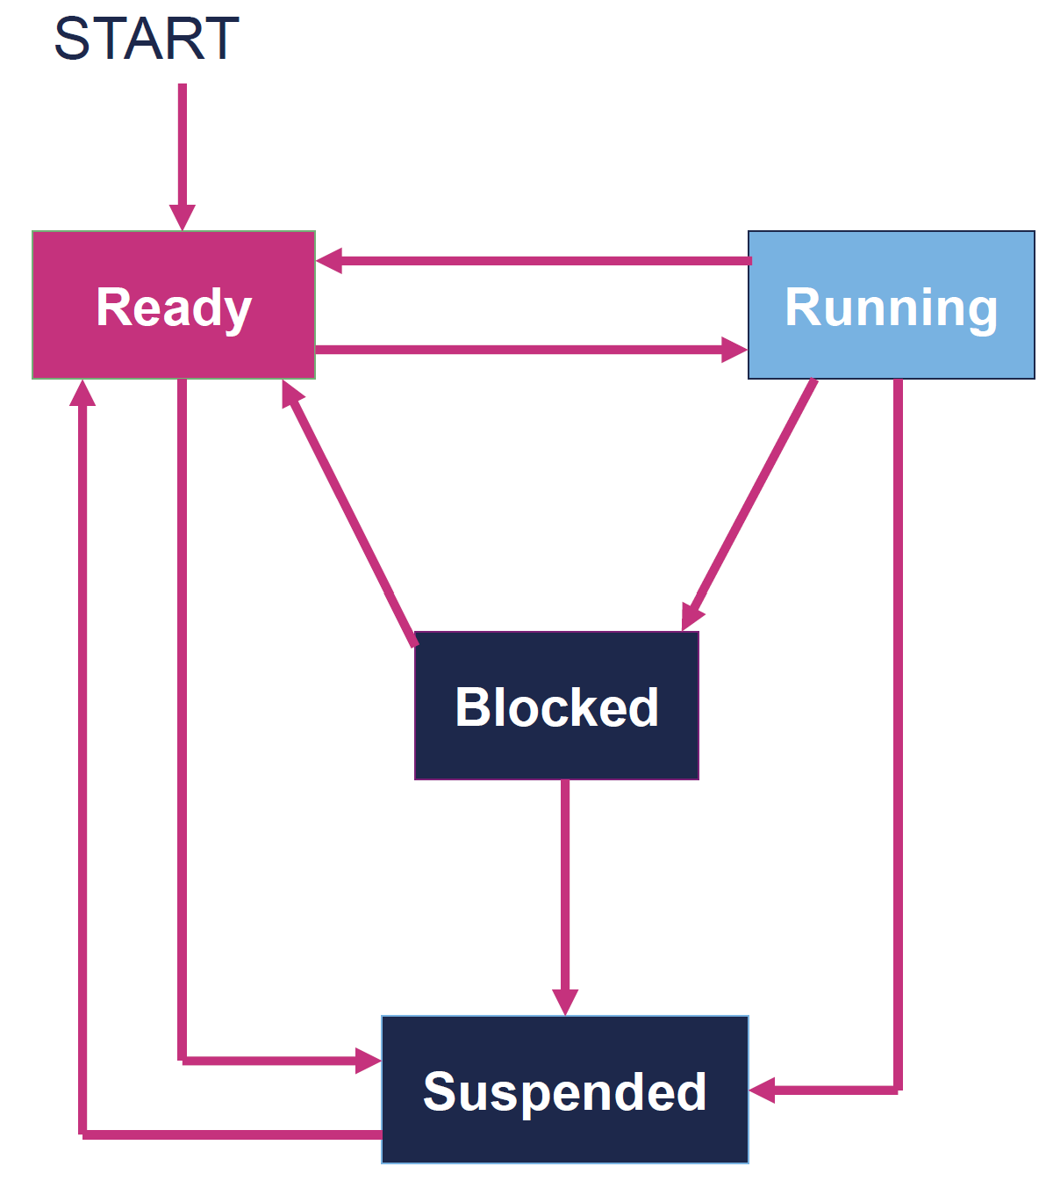
Task (Action)
Task is the smallest schedulable unit of work
Task is a piece of code run within infinite loop
Task usually has 4 states: ready, run, blocked, suspended
In a real-time system, there are many tasks run simultaneously
Each task has different priority
→ How to implement these tasks in realtime

Slide 16
Implement Real-time system
1950s-1970s
Bare-metal control loops
1980s
“Interrupt driven” real-time
2000s-now
Real-time Operating Systems (RTOS)
Late 1980s-1990s
Cooperative Scheduler

Slide 17
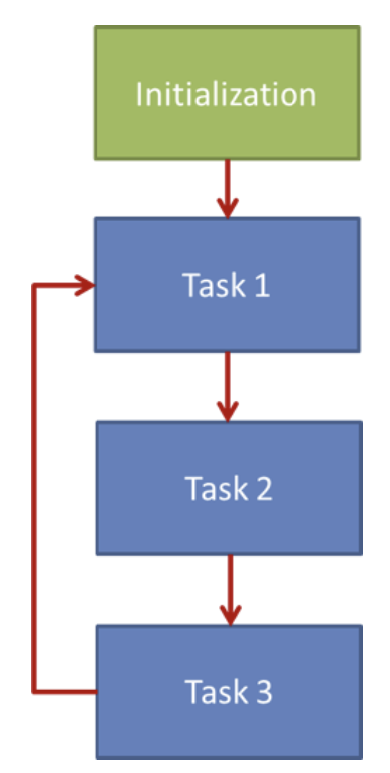
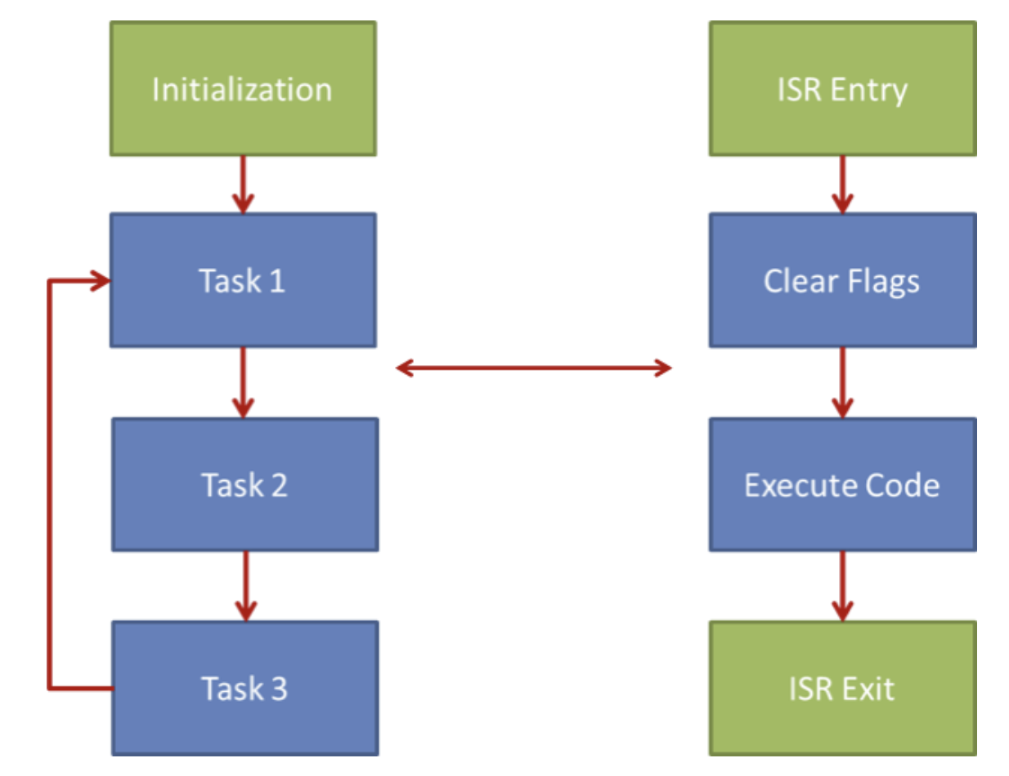
Implement Real-time system
Bare-metal control loops
Round Robin Scheduling
“Interrupt driven”
Round Robin with Interrupts
Notes:
Round robin: tasks have equal priority, Rotate through all tasks, Each task gets a fixed time slice

Slide 18
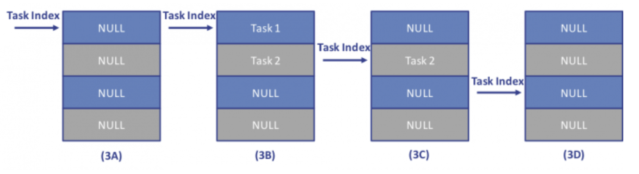
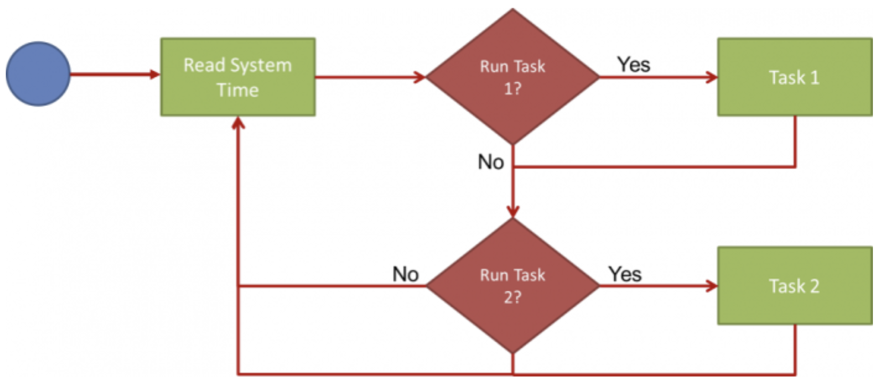
Implement Real-time system
Cooperative scheduling

Slide 19
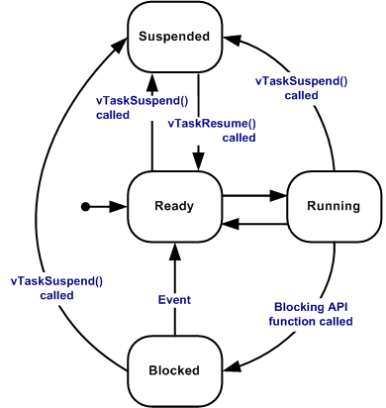
Implement Real-time system
Real-time OS Scheduling

Slide 20
Implement Real-time system
High Priority Task
Time
Low Priority Task
Real-time OS Scheduling

Slide 21
Implement Real-time system
High Priority Task
Time
Low Priority Task
Real-time OS Scheduling

Slide 22
Implement Real-time system
High & low priority jobs arrived together
High & low priority jobs arrived together
High Priority Task
Time
Low Priority Task
Real-time OS Scheduling

Slide 23
Implement Real-time system
High priority job is executed first
High Priority Task
Time
Low Priority Task
Real-time OS Scheduling

Slide 24
Implement Real-time system
High Priority Task
Low priority job is executed later
Time
Low Priority Task
Real-time OS Scheduling

Slide 25
Implement Real-time system
High Priority Task
High priority job arrived
Time
Low Priority Task
Real-time OS Scheduling

Slide 26
Implement Real-time system
High Priority Task
Lower priority job resumes later
Time
Low Priority Task
Real-time OS Scheduling

Slide 27
Implement Real-time system
High Priority Task
Time
Low Priority Task
Real-time OS Scheduling

Slide 28
Implement Real-time system
High Priority Task
Time
Low Priority Task
Real-time OS Scheduling

Slide 29
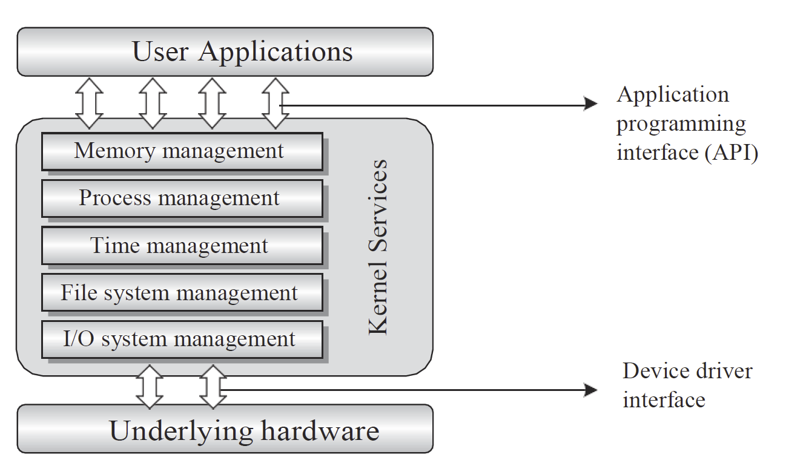
Operating system
The operating system acts as a bridge between the user applications, tasks and the underlying system resources
The OS manages the system resources and makes them available to the user applications/tasks
Primary functions of an operating system:
  Make the system convenient to use
  Organize and manage the system resources efficiently and correctly

Slide 30

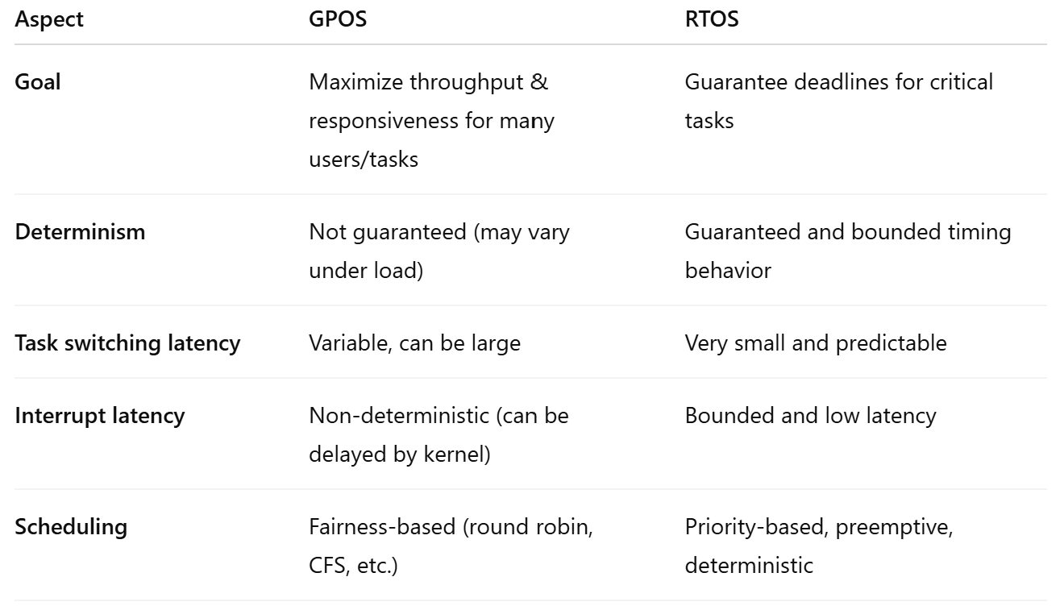





Types of Operating system

Slide 31
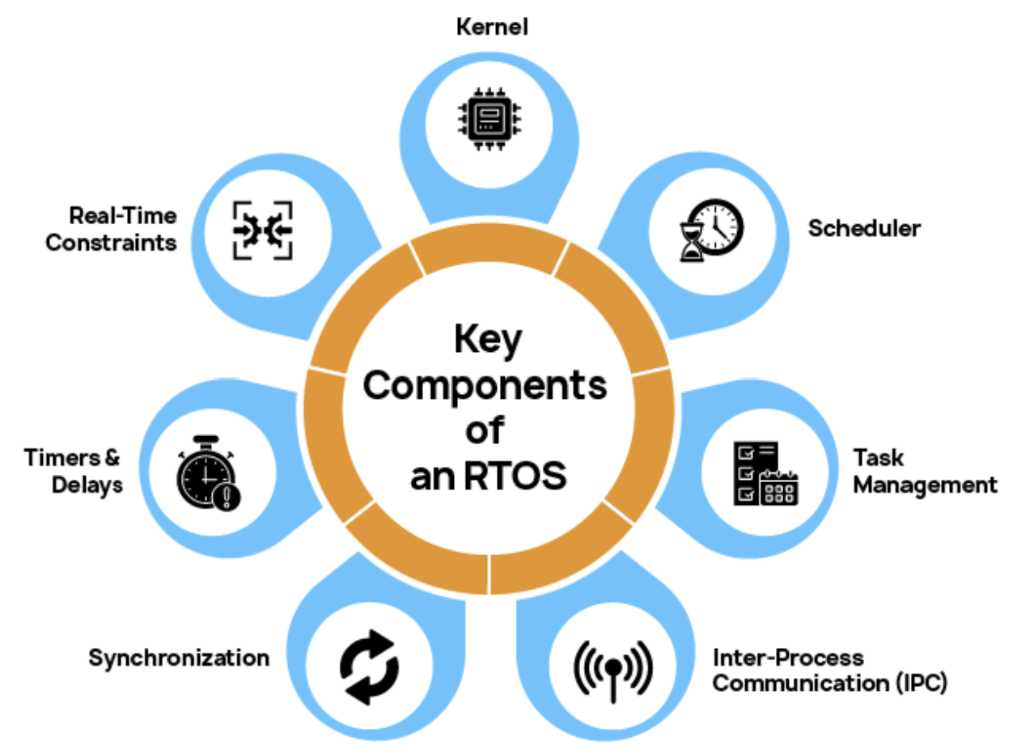
RTOS key components

Slide 32
RTOS key components
Kernel: The core of the RTOS that handles task management, resource allocation, context switching, and interrupt processing, all while maintaining deterministic performance.
Scheduler: Determines which task runs and when. Most RTOSs use preemptive or cooperative scheduling models, including priority-based and round-robin strategies. Advanced systems support deadline-driven scheduling for complex real-time needs.
Task Management: Supports the creation, suspension, resumption, and deletion of tasks or threads, enabling modular, concurrent application designs.
Inter-Process Communication (IPC): Includes mechanisms like message queues, semaphores, and mailboxes for safe and efficient data exchange between tasks, preventing race conditions and deadlocks.
Synchronization: Provides tools such as mutexes, binary semaphores, and event flags to manage shared resources and ensure data integrity.
Timers and Delays: Integrated support for software timers and precise delays enables time-triggered operations, task scheduling, and protocol timeouts.
Real-Time Constraints: RTOSs support hard real-time systems, where missing a deadline leads to critical failure (e.g., pacemakers, automotive safety systems), and soft real-time systems, where timing is important but not fatal (e.g., media streaming devices).

Slide 33
Implementation considerations
Some real-time embedded systems are complex, implemented on high-performance hardware
  Industrial plant control
  Civilian flight control
Many must be implemented on hardware chosen to be low cost, low power, light-weight and robust; with performance a distant concern
  Military flight control, space craft control
  Consumer goods
Often-times implemented in C or assembler, fitting within a few kilobytes of memory
  Correctness a primary concern, efficiency a close second

